Slide 1


Indian
Institute of
Technology
Madras

Slide 2

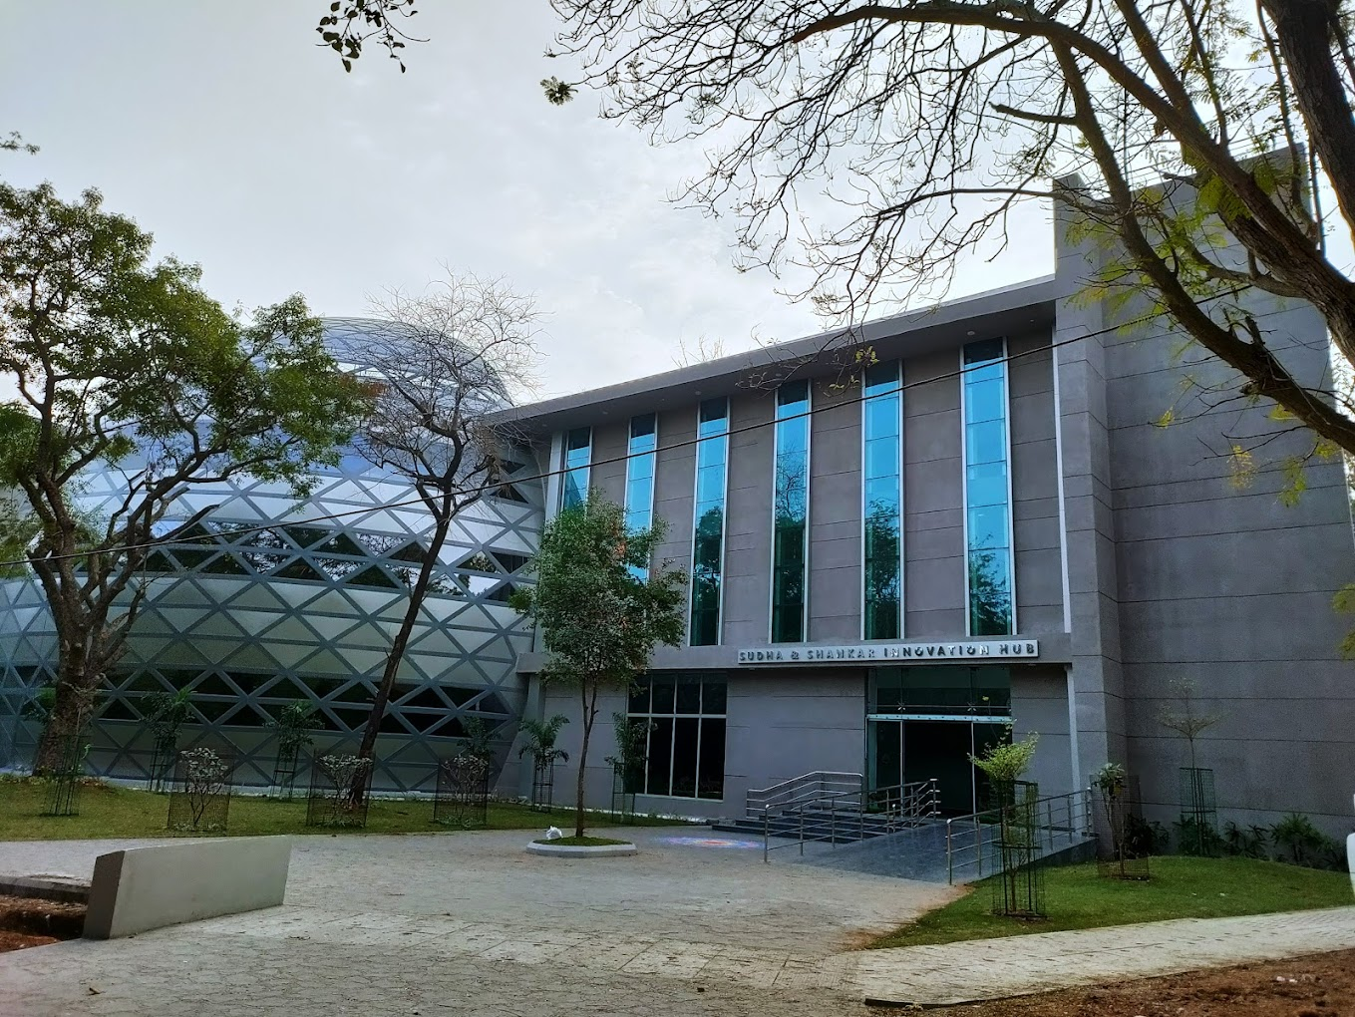
OFFICE OF GLOBAL ENGAGEMENT, IIT MADRAS
OFFICE OF
GLOBAL
ENGAGEMENT
YIF
Young International Faculty

Slide 3
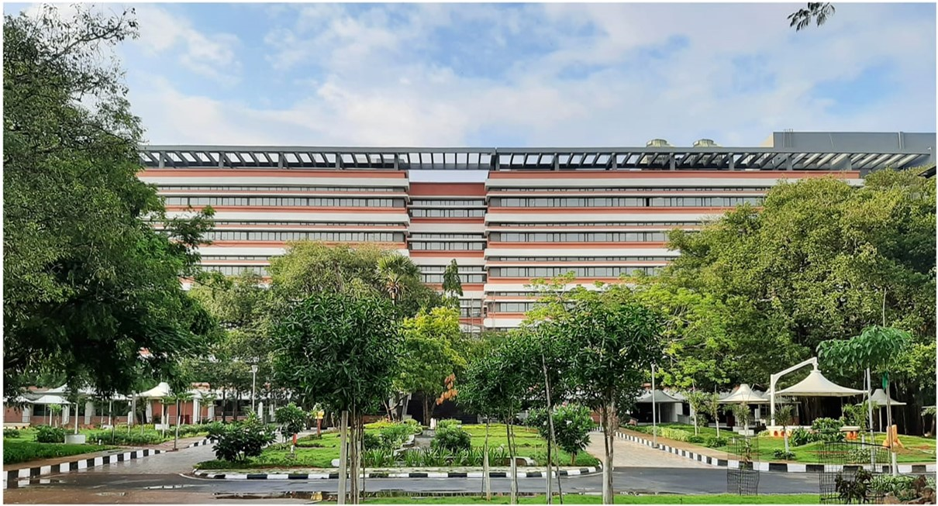
Agenda
OFFICE OF
GLOBAL
ENGAGEMENT
IIT Madras
About YIF
IIT Research Ambience
Objectives
Goals
YIF Selection Process
YIF Extension Process
Summary

Slide 4

IIT Madras in a Nutshell
OFFICE OF
GLOBAL
ENGAGEMENT
Founded in 1959 with assistance from the former government of West Germany
The third IIT established by the Government of India as an institute of National Importance
Initial teaching by German professors
IITM faculty trained by pursuing PhD in Germany and other countries
Direct German involvement ceased by 1973
Current Student Numbers
Then
Location : Chennai, Tamil Nadu, India
Campus: 620 Acres
Academic Departments: 16
Faculty: 600+
No. of students: 10000+
No. of Alumni: 50000+
No. of patents filed in 2020-21: 183
India's first university-driven research park - "IITM Research Park"
UG 2105
MSc 287
Dual Degree 2037
Now
MTech 1356
MBA 115
MA 240
MS 746
PhD 2963

Slide 5
About YIF
OFFICE OF
GLOBAL
ENGAGEMENT
The Young International Faculty program is designed for recent doctoral graduates or post-doctoral fellows (preferably within 3 years of finishing a PhD) from international universities worldwide
The YIF program allows faculty to supervise MS and PhD students and assist in teaching
A target is to recruit at least three YIF positions (on average) for every department at IIT Madras
The financial support IITM offers at par the Assistance professor level, including all benefits, will be roughly equivalent to 2000 Euros per month (subject to relevant experience)
IITM will also attempt to set up the YIF candidate with an industrial consultancy with companies in IITM Research Park

Slide 6
IIT Research Ambience
OFFICE OF
GLOBAL
ENGAGEMENT
Centers of Excellence
Translational and Nation-Building Research
IITM Research Park

Slide 7
IIT Madras Journey
OFFICE OF
GLOBAL
ENGAGEMENT
Founded in 1959 with assistance from the former government of West Germany
The third IIT established by the Government of India as an institute of National Importance
Initial teaching by German professors
IITM faculty trained by pursuing PhD in Germany and other countries
Direct German involvement ceased by 1973
Current Student Numbers
Then
Location : Chennai, Tamil Nadu, India
Campus: 620 Acres
Academic Departments: 16
Faculty: 600+
No. of students: 10000+
No. of Alumni: 50000+
No. of patents filed in 2020-21: 183
India's first university-driven research park - "IITM Research Park"
UG 2105
MSc 287
Dual Degree 2037
Now
MTech 1356
MBA 115
MA 240
MS 746
PhD 2963

Slide 8
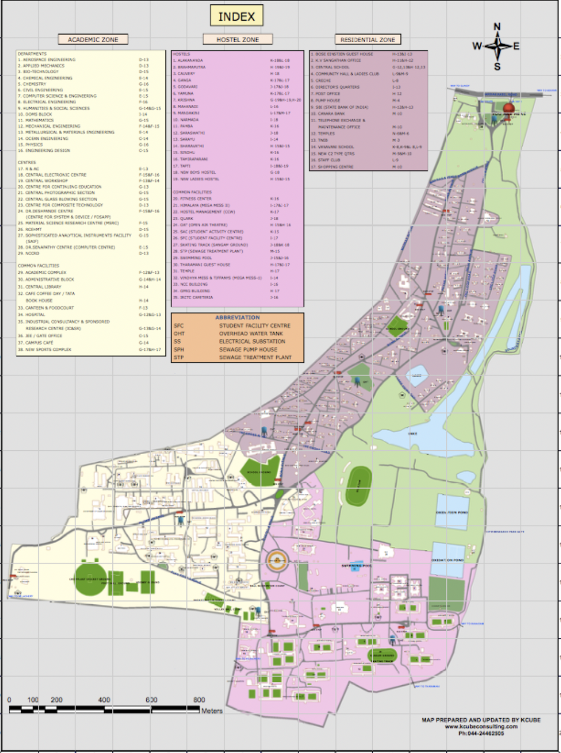
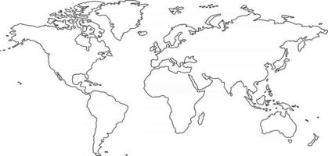
IIT Madras Core of Excellence
OFFICE OF
GLOBAL
ENGAGEMENT
Autonomy & independence
Quality of students and faculty
Commitment to teaching and research excellence
Singular focus on social relevance
Agility

Slide 9



Departments
OFFICE OF
GLOBAL
ENGAGEMENT
Aerospace Engineering
Applied Mechanics
Biotechnology
Chemical Engineering
Civil Engineering
Computer Science and Engineering
Electrical Engineering
Engineering Design
Mechanical Engineering
Metallurgical and Materials Engineering
Ocean Engineering
Mathematics
Physics
Chemistry
SCIENCE
Humanities & Social Sciences
Management Studies
ENGINEERING
SCHOOL OF MEDICAL SCIENCES (coming soon)
HUMANITIES & MANAGEMENT STUDIES

Slide 10
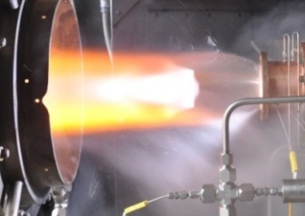
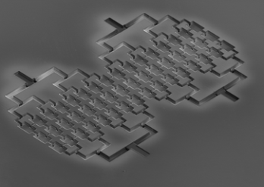
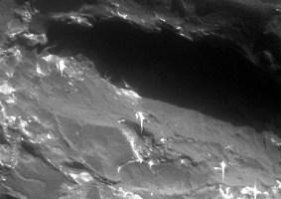


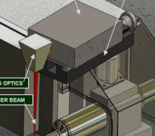
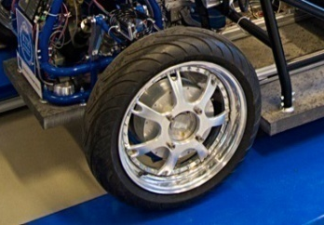



Applied/Translational Research Excellence
OFFICE OF
GLOBAL
ENGAGEMENT
Combustion Research
Nano-Devices &Materials
Decentralized Energy
Decision Sciences
Soft Matter
Machine Tools & Manufacturing
Non-destructive Testing
Tyre & Vehicle Dynamics
Transportation
Cancer Tissue Bio Bank
Digital Intelligence and Secure Hardware Architecture
Water Management and Policy
Affordable Sustainable Housing Accelerator
Hyperloop Technology
Energy Consortium
Brain Center

Slide 11
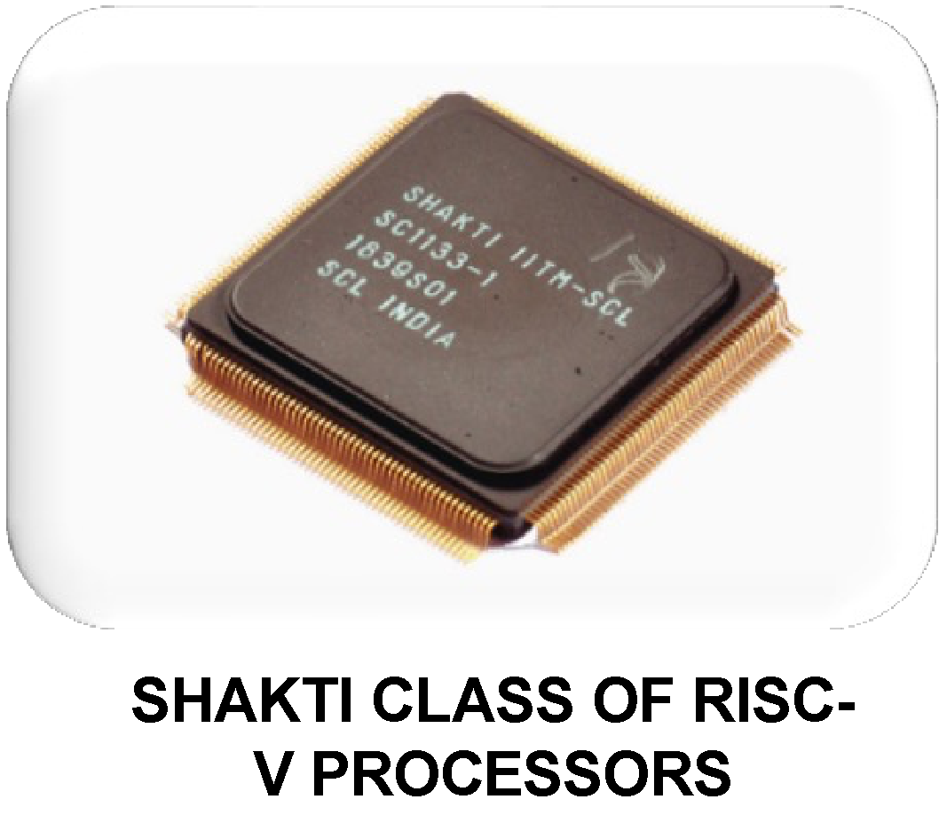
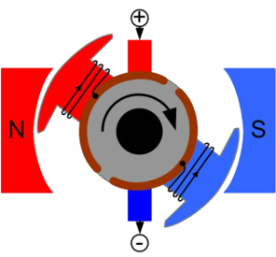
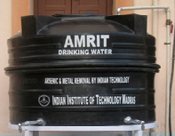

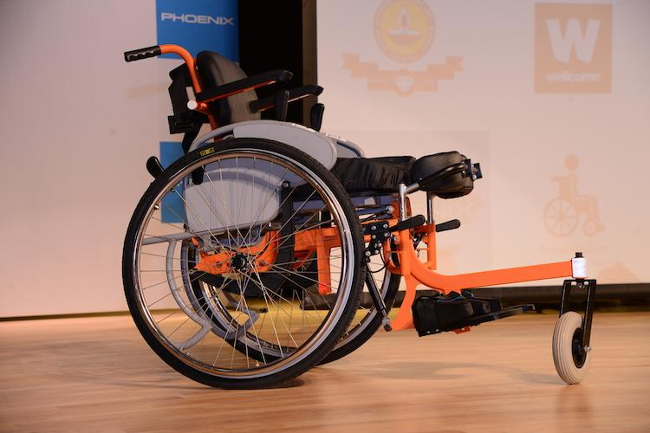


Nation Building
OFFICE OF
GLOBAL
ENGAGEMENT
Uninterrupted Power
5Gi
Clean Water
Assistive Devices
National Technology Center for Ports, Waterways and Coasts
Affordable Housing

Slide 12
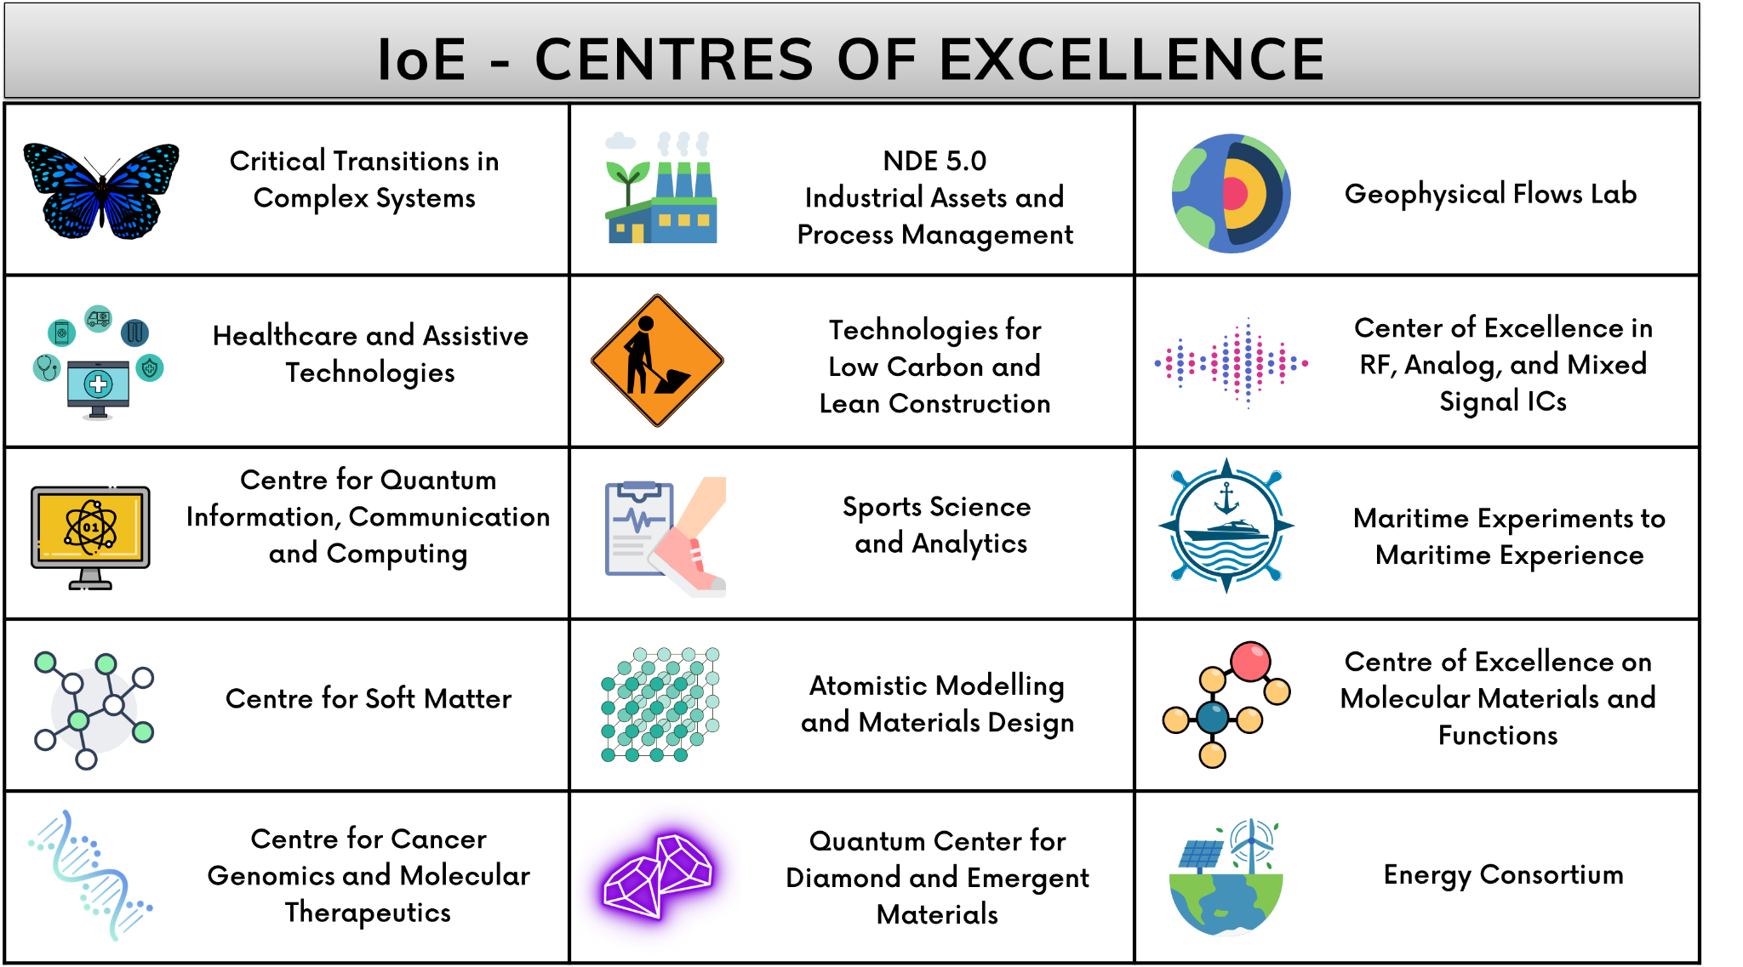
Institute of Eminence (IoE) Research Initiatives
OFFICE OF
GLOBAL
ENGAGEMENT

Slide 13

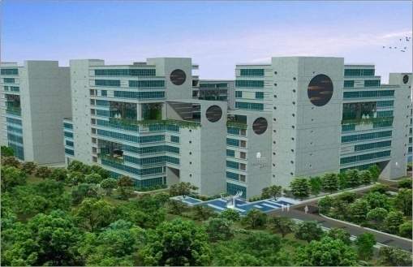

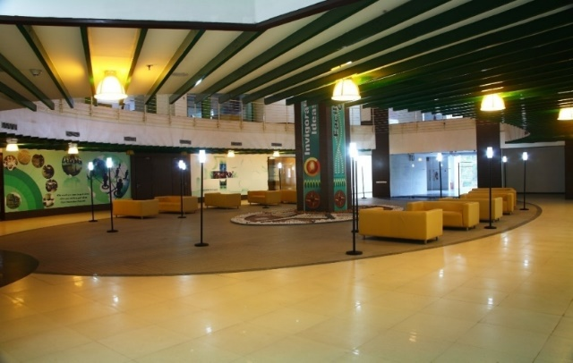
IITM RESEARCH PARK
OFFICE OF
GLOBAL
ENGAGEMENT
Bringing UNLIKE MINDS together

Slide 14

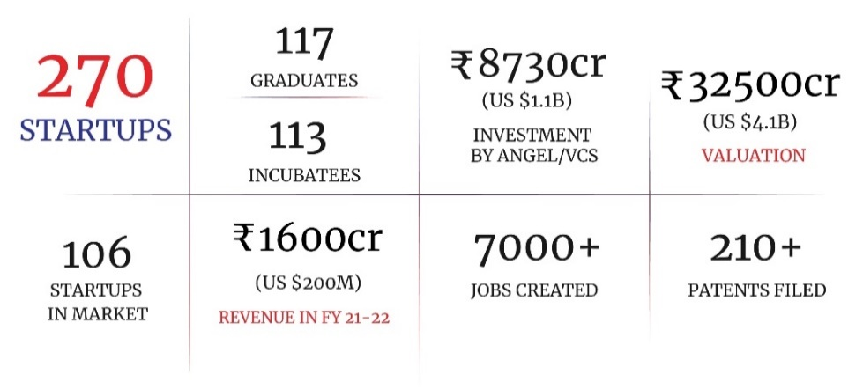
IITM’s Deep Tech Startup Hub
OFFICE OF
GLOBAL
ENGAGEMENT
557 Founders
IIT
  101 Cos. have IITM Faculty as founders or minority shareholders
  83 IIT faculty members are founders or minority shareholders

Slide 15
Previous YIFs and International Faculty @ IITM
OFFICE OF
GLOBAL
ENGAGEMENT
Young International Faculty at IIT Madras
Name of the Faculty | Country | Dept | From Year | To Year
Dr. Shotaro Tada | Japan | MME | 2022 | 2024
Dr. Gheeraert Nicolas | France | Phy | 2021 | 2023
Dr. Vladimir Ankudinov | Russia | MME
Dr Carlos Hernandez | United Kingdom | CY | 2019 | 2021
Dr Fabrice Mouhartem | France | CS | 2019 | 2021
Existing Full-Time International Faculty at IIT Madras
Name of Faculty | Country | Dept
Prof. Luoyi Tao | USA | AE
Prof. Roland Wittje | Germany | HSS
Prof. James Jim Libby | UK | PHY

Slide 16
Objectives
OFFICE OF
GLOBAL
ENGAGEMENT
To recruit tenure-track foreign faculty (non-Indian citizens/non-OCIs) at the equivalent level of Assistant Professor
Identify recent doctoral graduates and post-doctorates who would like to primarily focus on research with a host research group at IITM
YIF can Jointly supervise MS and PhD students and also aid in teaching

Slide 17
Goals
OFFICE OF
GLOBAL
ENGAGEMENT
Target to fill at least three YIF positions (on average) from each department.
~51 YIFs in a year across 17 Departments
Internationalize the faculty pool at IIT Madras

Slide 18
YIF Selection Process
OFFICE OF
GLOBAL
ENGAGEMENT
Application sent to the department for the selection procedure
APPLICATION RECEIVED THE THROUGH PORTAL
Review the application and confirm that the applicant will collaborate with >3 faculty. The committee will consist of HOD, three potential faculty collaborators (other than the main collaborator) and other members as decided by the HOD.
THE FORMED COMMITTEE WILL REVIEW THE APPLICATION
Issuance of the offer letter to the selected applicant by the Dean of Faculty
ISSUE THE OFFER LETTER WITH THE BOARD OF GOVERNERS APPROVAL
EXTERNAL REVIEWERS RECOMMENDATION
Opinions and recommendations by external experts and mentors will be considered by the committee
Based on the overall assessment, the committee recommends the YIF application (through the Department Consultative Committee (DCC)) to the Dean of Faculty for further processing of the application, marking a copy to the Dean Admin and Dean Global
DECISION THROUGH DCC TO DEAN OF FACULTY
SEMINAR BY APPLICANT
The committee invites the applicant for a professional seminar based on the recommendations

Slide 19
YIF Extension Process
OFFICE OF
GLOBAL
ENGAGEMENT
YIF does not want to co-guide a student
YIF will not get Adjunct Faculty position
After 2 years of position if YIF wants to leave
Wants to still
co-guide a student
YIF will get Adjunct Faculty position at IITM
YIF (Initial 2 years position)
YIF extension
3 years of extension automatically allows guiding of Master students
Five year rolling contract
IITM does not extend the position
>2 yrs
No more co-guide privileges

Slide 20
Summary
OFFICE OF
GLOBAL
ENGAGEMENT
Objective:
IITM will offer Young International Faculty positions at the equivalent level of Assistant Professor for recent doctorates and post-doctoral fellows (No-Indian citizens/ Non-OCIs) from renowned universities across the globe
YIF will primarily focus on academic research with the host research group at IIT Madras YIF can jointly supervise MS and PhD students and aid in teaching
Financial Support:
The financial support IITM offers at par the Assistance professor level, including all benefits,
is approximately INR Rs. 1,80,000 or 2000 Euros per month (subject to relevant experience)
IITM will facilitate consultancy projects from the IITM-RP companies for the YIF
History and Target:
A total of 5 YIFs have joined IITM since 2019 from various parts of the world Target to fill at least three YIF positions from each department
~51 YIFs in a year across 17 Departments

Slide 21
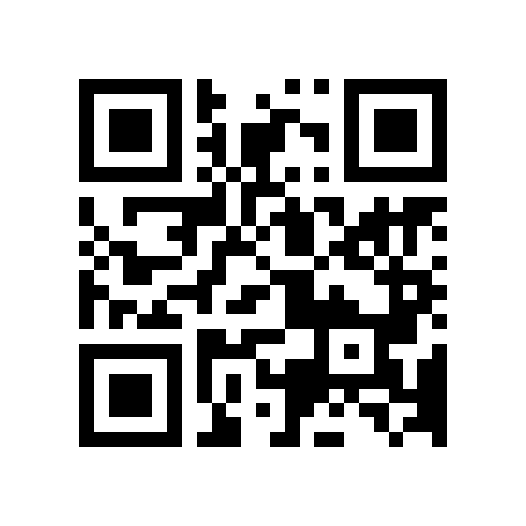
Contact
OFFICE OF
GLOBAL
ENGAGEMENT
For more info, please visit: www.ge.iitm.ac.in/yif
Contact:
Mrs. Rupa S. Pandit
International Faculty Coordinator
Office of Global Engagement, IIT Madras
Phone No.: +9144-2257-8869
Email: projects@ge.iitm.ac.in
Website: http://www.ge.iitm.ac.in/

