Slide 1
Guidelines for Preparing the Slides
International Conference on Experimental Mechanics
October 20-23, 2024
IIT Madras

Slide 2
Guidelines for Preparing Slides
The widescreen format (16:9) used here is preferred.
The authors are free to use a colour scheme and a design of the slide that best suits their presentation.
Creatively use the conference logo ICEM2024 and ASEM logo (available on the first slide) to enhance your presentation.
The content of the slides needs to be visible clearly to the participants.
Usually, the Arial font is visible even at small sizes. For titles, use 28pt; for text, 24pt; for sub-points, 22pt; the graph markings should be about 14pt, and for references showing acknowledgments, 11 pt.
Line spacing of 1.2 improves readability.

Slide 3
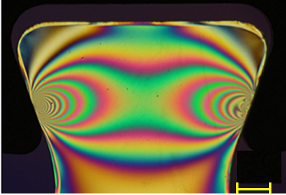
Images and Graphs
An image is often more impactful and is worth a thousand words.
A well-drawn graph or figure is more appealing and effective than extensive textual content.
Proper courtesy should be appropriately provided for images used in the presentation if they are not part of the original work by the authors
Provide scale if applicable and also the legend for the colours used.
0
1
2
3
N
5 mm
Image courtesy: Ramesh, K., and Muktai Thomre. "Evaluation of Critical Crack Orientations and Crack Growth Analysis in Compressor Blade Root Subjected to Fatigue." Journal of Engineering for Gas Turbines and Power 142.4 (2020): 041022.

Slide 4
Guidelines for Preparing the Slides
Suitably animate the text or figures to enhance the appeal of the presentation.
If you are including movies, ensure that they play properly as part of the PPT.
Ensure that the content flows downward. If the presenter wants to revisit previous slide contents, it is advisable to include them in the upcoming slide instead of going back.
Timing of the presentation is very important and choice of words to explain the content clearly without any ambiguity requires proper planning and suitable rehearsals.

Slide 5
Guidelines for Preparing the Slides
The time limit for a contributed paper is 20 minutes that includes presentation and discussion.
Typically, a slide requires about 1 minute – if the content is just a figure, then it may be about 30 s.
In all, one needs only about 25 slides and it is highly recommended that the presentation is rehearsed in your research group several times and timed properly.
While planning, anticipate questions and have these slides ready after completion of the talk - this way, it prompts discussion, and the session is livelier and more useful.

Slide 6
Guidelines for Preparing the Slides
To hone up your presentation skills further, a trial room will be available at the conference venue for presenters to practice.
Kindly stick to the time limit so that the registrants can move from one session to another session of their choice to derive maximum benefit from the conference.
One can continue the discussion at tea time or during lunch.
A good presentation will go a long way in securing the Best paper award of the conference.
Hope you enjoy your presentation and also the conference.

